Slide 1
GPM Mission Overview
15 November, 2022

Slide 2
Learning Objectives
Understand the basics of remote sensing of precipitation
Identify NASA satellites and sensors used for deriving precipitation
describe precipitation data available from these sensors
describe data used to track below and above normal precipitation

Slide 3
Presentation Outline
Precipitation Remote Sensing
NASA Precipitation Missions and Data
Global Precipitation Measurements (GPM) Mission and Tropical Rainfall Measuring Mission (TRMM)
TRMM and GPM Data Products
TRMM/GPM Data Access and Visualization
Demonstration Precipitation Processing System – STORM
Demonstration of Giovanni

Slide 4
Precipitation Remote Sensing

Slide 5
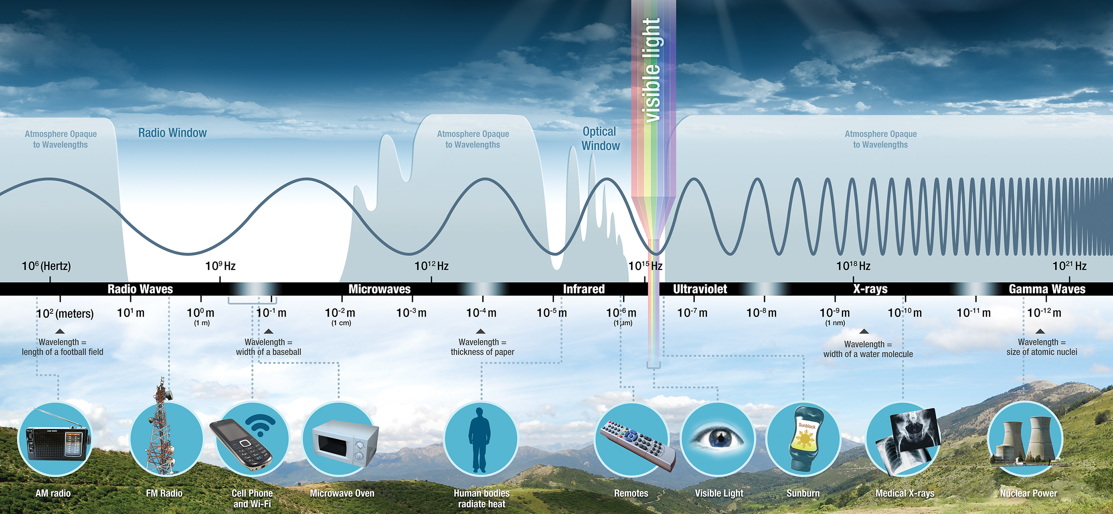
Spectral Bands Used for Precipitation Remote Sensing
Derived from:
reflected visible radiation (0.5 to 0.6 micrometer wavelength)
emitted infrared radiation (10-12 micrometer wavelength)
emitted microwave radiation (10 to 183 Ghz frequency or mm to cm wavelength)
Notes:
Inferred indirectly from emitted Infrared radiation by clouds (Passive Remote Sensing)

Slide 6
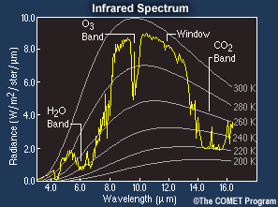
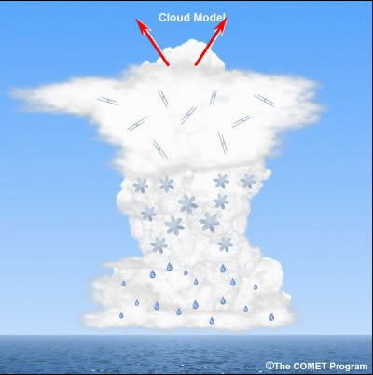
Precipitation Remote Sensing
Passive Remote Sensing: Inferred indirectly from emitted infrared (IR) radiation by clouds
Image Credit (Left): UCAR COMET, comet.ucar.edu
Notes:
Inferred indirectly from emitted Infrared radiation by clouds (Passive Remote Sensing)

Slide 7
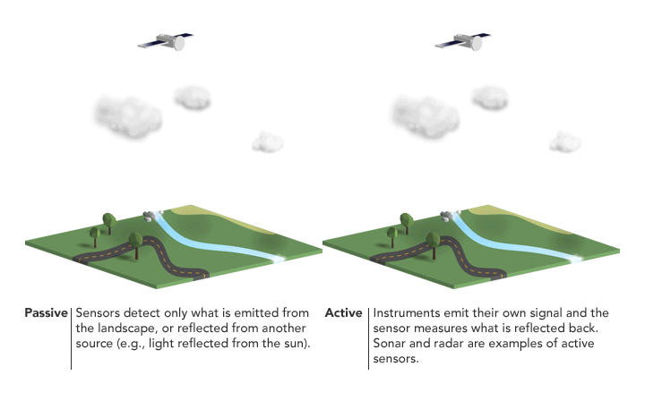
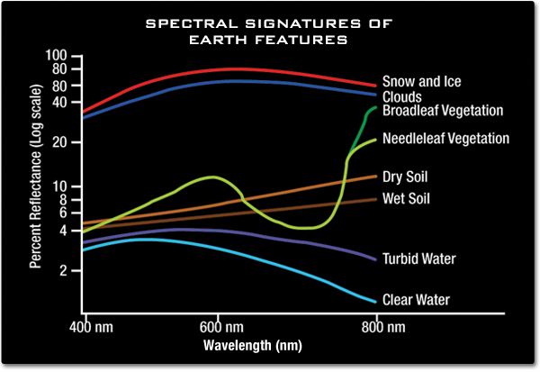
Precipitation Remote Sensing
Passive Remote Sensing: Inferred indirectly from reflected solar visible (VIS) radiation by clouds
Image Credit (Left): UCAR COMET, comet.ucar.edu
Notes:
Inferred indirectly from emitted Infrared radiation by clouds (Passive Remote Sensing)

Slide 8
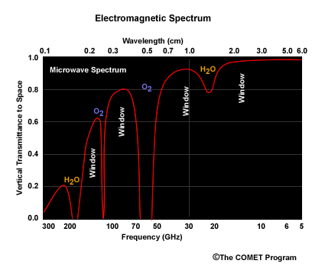
Precipitation Remote Sensing
Passive Remote Sensing: Estimated from microwave radiation emitted or scattered by precipitation particles
The lower frequencies, referred to as “emissions channels,” measure precipitation mainly from energy emitted by raindrops (37 GHz)
The higher frequencies, or “scattering channels,” gather energy scattered by ice particles above the freezing level (85 GHz)
85 GHz
37 GHz
Image Credit (Left): UCAR COMET, comet.ucar.edu

Slide 9
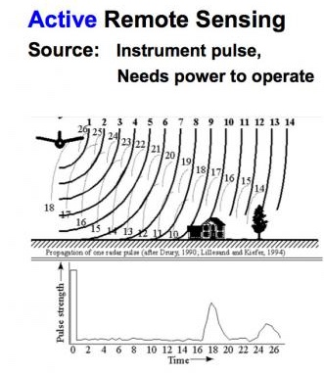
Precipitation Remote Sensing
Active Remote Sensing: Estimated from back-scattered microwave radiation transmitted by radars
NASA Satellites TRMM and GPM use K-band radar
K-band generally has a frequency range within 27-40 GHz and 12-18 GHz
Image Credit: Paul Messina, Hunter College
Notes:
NASA Satellites TRMM and GPM use K-band radar
K-band generally has a frequency range within 27-40 GHz and 12-18 GHz

Slide 10
NASA Precipitation Missions and Data

Slide 11
GPM and TRMM
http://pmm.nasa.gov/
Dedicated Missions to measure rainfall from active and passive microwave observations:
Predecessor to Global Precipitation Measurement (GPM) Mission
Tropical Rainfall Measurement Mission (TRMM)*
*TRMM is no longer available, but very important for long-term rainfall data
Notes:
The first satellite mission dedicated to measuring tropical and subtropical rainfall - Launched on 27 November 1997 and ended on 15 April 2015
First satellite to carry a microwave Precipitation Radar
Predecessor to Global Precipitation Measurement (GPM)

Slide 12
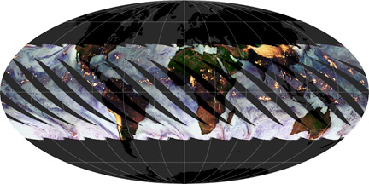
TRMM Sensors
http://trmm.gsfc.nasa.gov/
In a non-polar, low-inclination orbit
Altitude of approximately 350 km, raised to 403 km after August 23, 2001
Spatial Coverage
16 TRMM orbits a day covering global tropics between 35°S – 35°N latitude
TRMM Orbits

Slide 13
TRMM Sensors
http://trmm.gsfc.nasa.gov/
Sensors:
TRMM Microwave Imager (TMI)
Precipitation Radar (PR)
Visible and Infrared Scanner (VIRS)
Lightening Imaging Sensor (LIS)
Clouds and the Earth’s Radiant Energy System (CERES)
TRMM Orbits

Slide 14
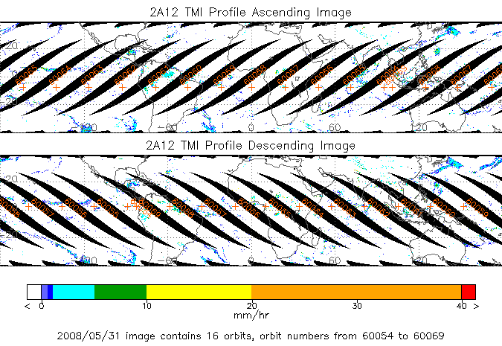
TRMM Microwave Imager (TMI)
http://pmm.nasa.gov/TRMM/TMI
Spatial Coverage and Resolution:
Coverage: -180° – 180°, 35°S – 35°N
Swath: 760 km (878 km after 8/2001)
Vertical Resolution:
0.5 km from surface – 4 km
1.0 km from 4-6 km
2.0 km from 6-10 km
4.0 km from 10-18 km
TMI Swaths
Notes:
Spatial Coverage and Resolution:
-180° to 180°, 35°S-35°N
Swath: 760 km (878 km after 8/2001) Spatial resolution: 5 to 45 km (channel-dependent)
Vertical Resolution:
.5 km from surface to 4 km 1.0 km from 4 to 6 km 2.0 km from 6 to 10 km 4.0 km from 10 to 18 km
Temporal Coverage and Resolution:
Nov. 27,1998 - Oct 7, 2014
~12 hour revisit time

Slide 15
TRMM Microwave Imager (TMI)
http://pmm.nasa.gov/TRMM/TMI
Temporal Coverage and Resolution:
November 27, 1998 - April 15, 2014
16 orbits per day
Chanel Frequencies
10.7, 19.4, 21.3, 37, 85.5 GHz
TMI Swaths
Notes:
Spatial Coverage and Resolution:
-180° to 180°, 35°S-35°N
Swath: 760 km (878 km after 8/2001) Spatial resolution: 5 to 45 km (channel-dependent)
Vertical Resolution:
.5 km from surface to 4 km 1.0 km from 4 to 6 km 2.0 km from 6 to 10 km 4.0 km from 10 to 18 km
Temporal Coverage and Resolution:
Nov. 27,1998 - Oct 7, 2014
~12 hour revisit time

Slide 16
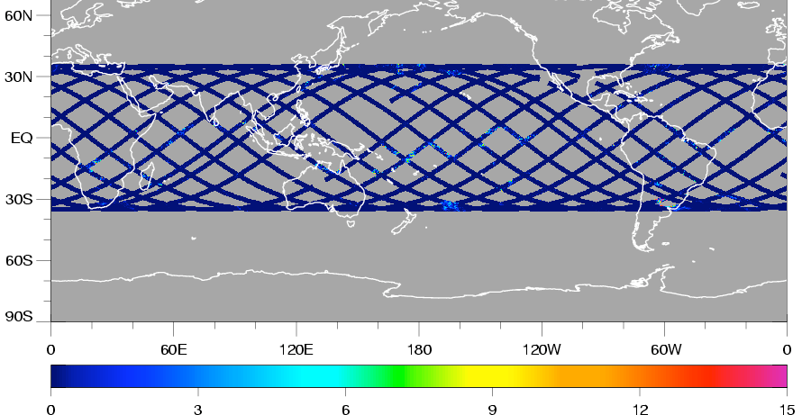
Precipitation Radar (PR)
http://pmm.nasa.gov/TRMM/PR/
Spatial Coverage and Resolution:
Coverage: 35°S – 35°N
Swath: 215 km (247 after 8/2001)
Spatial Resolution: 4.3 km (5 km)
Vertical Resolution: 250 m (from 0-20 km)
Temporal Coverage and Resolution:
November 27, 1998 – October 7, 2014
~16 orbits per day
Frequency:
13.6 GHz
PR Swaths
Kummerow, C., et. al, 1998: The tropical rainfall measuring mission (TRMM) sensor package, J. Atmos. Oceanic Technol., 15, 809-817.

Slide 17
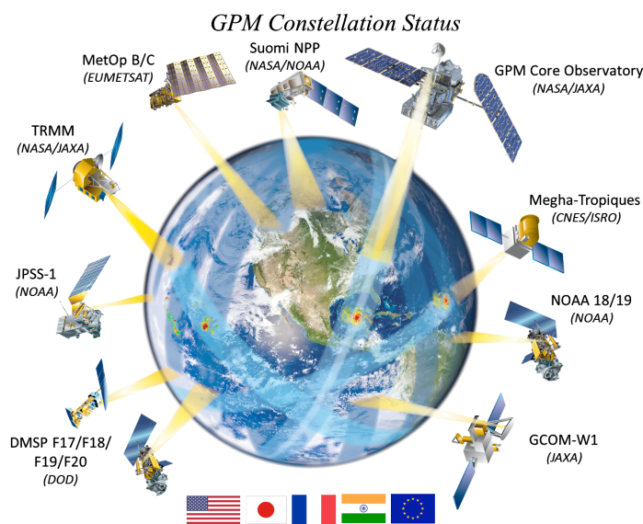
GPM Satellite & Sensors
http://pmm.nasa.gov/GPM/
Core satellite launched Feb 27, 2014
in a non-polar, low inclination orbit
Altitude: 407 km
Spatial Coverage
16 day orbits a day, covering global area between 65°S – 65°N
Along with constellation of satellites, GPM has a revisit time of 2-4 hrs over land
Sensors
GMI (GPM Microwave Imager)
DPR (Dual Precipitation Radar)

Slide 18
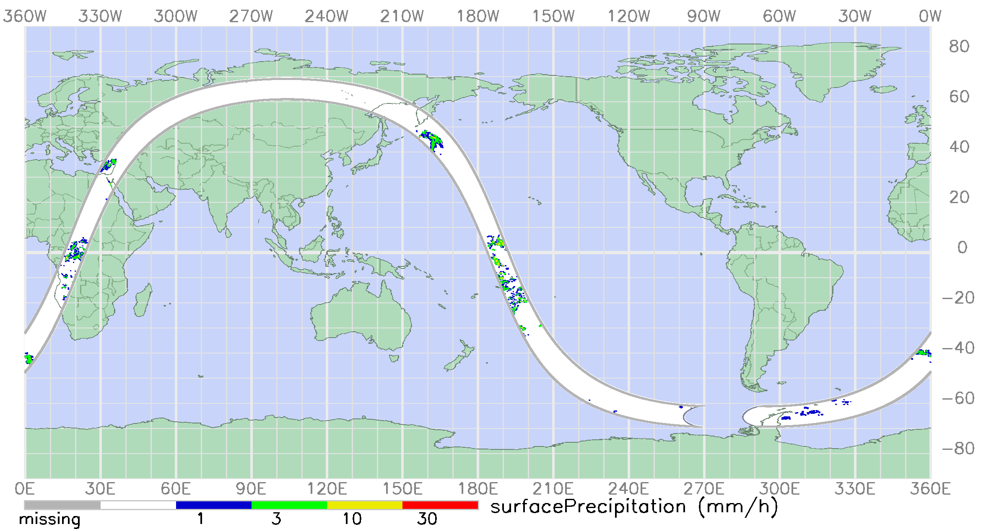
GPM Microwave Imager (GMI)
http://pmm.nasa.gov/GPM/flight-project/GMI/
Spatial Coverage and Resolution:
Coverage: -180°-180°, 65°S - 65°N
Swath: 885 km
Spatial Resolution: 4.4-32 km
Vertical Resolution:
0.5 km from surface – 4 km
1.0 km from 4-6 km
2.0 km from 6-10 km
4.0 km from 10-18 km
GMI Swath

Slide 19
GPM Microwave Imager (GMI)
http://pmm.nasa.gov/GPM/flight-project/GMI/
Temporal Coverage and Resolution
Feb 2014 – present, ~2-4 hr observations
Channel Frequencies
10.6, 18.7, 23.8, 36.5, 89, 166, 183 GHz
GMI Swath

Slide 20
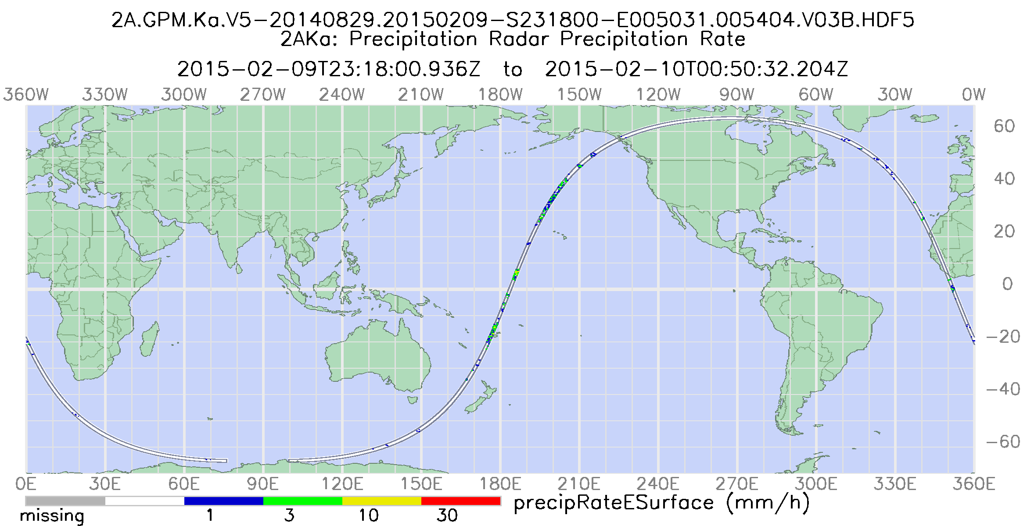
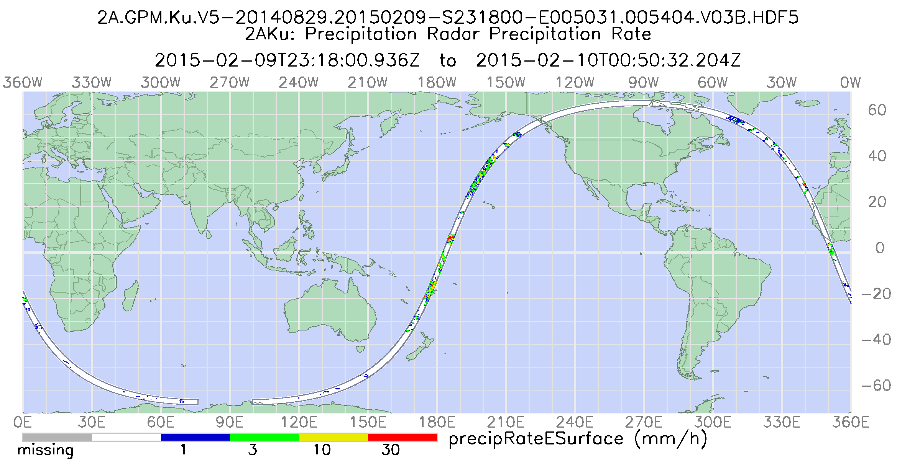
Dual Precipitation Radar (DPR)
http://pmm.nasa.gov/GPM/flight-project/DPR/
Spatial Coverage and Resolution:
Coverage: -180°-180°, 65°S-65°N
Swath: 120km (Ka) and 245km (Ku)
Spatial Resolution: 5.2km
Vertical Resolution: 250m (from 0-20km)
Temporal Coverage and Resolution:
Feb 27, 2014 – present
~2-4 hr observations
Frequency:
13.6 and 35.5 GHz
DPR Swaths
Ka 35.5 GHZ
Ku 13.6 GHZ

Slide 21
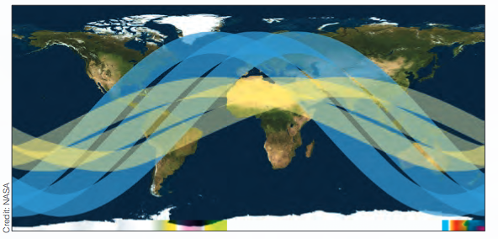
TRMM and GPM Comparison
GMI & DPR
provide improved reference standards for inter-calibration of constellation precipitation measurements
better accuracy measurements
GMI has a higher spatial resolution than TMI
Improved light rain and snow detection in GMP
DPR has better identification of liquid, ice, mixed-phase precipitation particles
GPM
TRMM
TRMM measurements are limited to the tropics
GPM measurements span middle and high latitudes
Notes:
GMI and DPR provide improved reference standard for inter-calibration of constellation precipitation measurements compared to TMI/PR
Better accuracy of measurements for GMI & DPR
GMI has Higher spatial resolution than TMI
Improved light rain and snow detection in GPM (TRMM can not detect rainfall <0.5 mm/hr)
DPR has better identification of liquid, ice, mixed-phase precipitation particles

Slide 22
Importance of TRMM Data Products
TRMM provided high resolution precipitation data for 17 years
Useful for detecting and understanding climate variability and change
Many applications are developed from TRMM data and still have to transition to using GPM data
extreme rain, flood, and drought monitoring and mapping
agriculture
Health
TRMM and GPM data will be inter-calibrated to provide a combined long-term precipitation record in 2018
Notes:
TRMM has ended, but it’s important to learn about TRMM data because:

Slide 23
Precipitation Algorithms for TRMM and GPM
http://pmm.nasa.gov/science/precipitation-algorithms
There are four major algorithms used to obtain precipitation estimates from GPM/TRMM observations:
Radar Algorithms
Radiometer Algorithms
Combined Radar + Radiometer Algorithms
Multi-Satellite Algorithms
TRMM and GPM Core are used as calibrators for multiple national and international constellation satellites

Slide 24
Summary of TRMM Level-2 Precipitation Products
Sensor or Product Name | Spatial Resolution & Coverage | Temporal Resolution | Data Format
PR only: 2A25 | 5 km x 5 km Single orbit 16 orbits/day (35°S–35°N) | 7-day latency for near real-time 3-hour, 2-day, 5-day | HDF4
TMI only: 2A12 | 5 km x 5km Orbital 16 orbits/day (38°S–38°N) | 3-hour, 2-day, 15-day
Combined TMI & PR: 2B31 | 5 km x 5 km Orbital 16 orbits/day (38°S–38°N) | 7-day latency for near real-time 3-hour, 2-day, 5-day

Slide 25
Summary of TRMM Level-3 Precipitation Products
Sensor or Product Name | Spatial Resolution & Coverage | Temporal Resolution | Data Format
TMPA: 3B42RT & Final 3B42 | 0.25°×0.25° 50°S×50°N | RT is NRT with 8 hr latency 3-hourly | RT data in binary and OpenDAP
TMPA: 3B43 |  | Monthly 2 month latency | HDF4 NetCDF
PR only: 3A12 | 0.5°×0.5° and 5°×5° 37°S×37°N | Monthly | HDF4 OpenDAP
TMI only: 3A12 | 0.5°×0.5° 38°S×38°N | Monthly
TMI-PR Combined: 3B31 | 5°×5° 40°S×40°N | Monthly

Slide 26
Summary of GPM Level-2 Precipitation Products
Sensor or Product Name | Spatial Resolution & Coverage | Temporal Resolution | Data Format
DPR Ku-only: 2A-Ku | 5.2 km x 125 m Single orbit 16 orbits/day (70°S-70°N) | 20-120 minutes 24 hrs | HDF5 OpenDAP
DPR Ka-only: 2A-Ka
DPR Ku & Ka: 2A-DPR
GMI/2A-GPROF | 4 km x 4 km Orbital 16 orbits/day (70°S-70°N) | 2-40 hrs
Combined GMI+DPR:2A-CMB | 5 km x 5 km Orbital (70°S-70°N) Coincident Ku-Ka GMI footprints | 3-40 hrs
Notes:
DPR Ku-only/ 2A-Ku
DPR Ka-only/2A-Ka
DPR KU & Ka/
2A-DPR

Slide 27
Summary of GPM Level-3 Precipitation Products
Sensor or Product Name | Spatial Resolution & Coverage | Temporal Resolution | Data Format
IMERG | 0.1°×0.1° 90°S-90°N | 30 min (NRT) 6 hr, 16 hr, & 3 month latency | HDF4 NetCDF OpenDAP ASCII .gif, .png KML (Google Earth)
Combined GMI + DPR Rainfall Averages: 3-CMB | 0.1°×0.1° 70°S-70°N | Monthly
DPR Rainfall Averages: 3-DPR | 0.25°×0.25° 5.0°×5.0° Daily: 67°S-67°N Monthly: 70°S-70°N | Daily & Monthly
GMI Rainfall Averages: 3-GPROF | 0.25°×0.25° 90°S-90°N | Daily & Monthly

Slide 28
Multi-Satellite Algorithms for TRMM and GPM
http://pmm.nasa.gov/science/precipitation-algorithms
TRMM & GPM core satellites are used to calibrate microwave observations from a constellation of national and international satellites
Allow improved spatial and temporal coverage of precipitation data
TRMM Multi-satellite Precipitation Analysis (TMPA)
Widely used for applications
TMPA will be extended to match Integrated Multi-satellitE Retrievals for GPM (IMERG)

Slide 29
TRMM Multi-satellite Precipitation Analysis (TMPA)
http://precip.gsfc.nasa.gov/trmm_comb.html
TMPA combines PR & TMI rain rates
Inter-calibrates passive rain rates from other satellite sensors
TMI, SSM/I (Special Sensor Microwave Imager), AMSR (Advanced Microwave Scanning Radiometer, Aqua), AMSU-B (Advanced Microwave Sounding Unit, NOAA), MHS (Microwave Humidity Sounder), IR radiometers*
Inter-calibrates with national and international geostationary and NOAA low-earth orbiting satellites infrared measurements by using VIRS
Final rain product is calibrated with rain gauge analyses on a monthly time scale

Slide 30
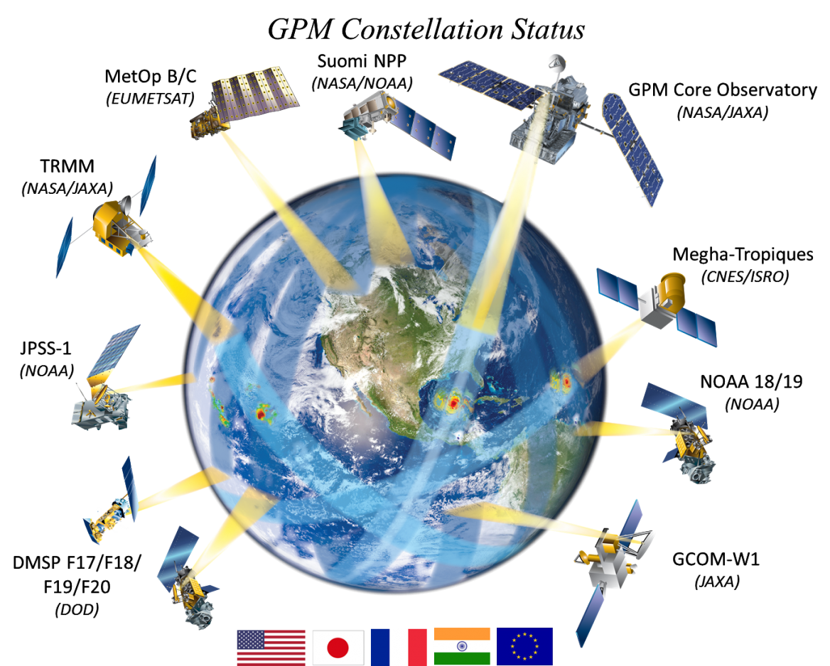
Integrated Multi-satellitE Retrievals for GPM (IMERG)
http://pmm.nasa.gov/sites/default/files/document_files/IMERG_ATBD_V4.5.pdf
Conceptually similar to TMPA
GPM constellation satellites include:
GCOM-W
DMSP
Megha-Tropiques
MetOp-B
NOAA-N’
NPP
NPOESS
Final rain product is calibrated with rain gauge analyses on monthly time scale
Notes:
https://pmm.nasa.gov/category/keywords/imerg

Slide 31
Integrated Multi-satellitE Retrievals for GPM (IMERG)
http://pmm.nasa.gov/sites/default/files/document_files/IMERG_ATBD_V4.5.pdf
Multiple runs accommodate different user requirements for latency and accuracy
“Early” – now 5 hours (flash flooding) – will be 4 hours
“Late” – now 15 hours (crop forecasting) – will be 12 hours
“Final” – 3 months (research data)
Native time intervals are half-hourly and monthly (final only)
Value-added products at 3 hrs, 1, 3, and 7 days - .tiff will be available
Initial release covers 60°N-60°S – will be 90°N-90°S

Slide 32
TMPA and IMERG
 | TMPA | IMERG
Spatial Resolution | 0.25° x 0.25° | 0.1° x 0.1°
Spatial Coverage | Global, 50° S – 50°N | Global, 60°S – 60°N (will be extended from pole to pole)
Temporal Resolution | 3 hours | 30 minutes
Temporal Coverage | 12/1997 – present* | 2/27/2014 – present⁺
* After April 8, 2015, TRMM climatological calibration is being used to generate TMPA
⁺TMPA and IMERG combined data will be available in early 2018 at IMERG data resolution

Slide 33
TRMM and GPM Data Type Convention
Learn More: https://go.nasa.gov/2y7AouZ
Type | Description
1A | Instrument count, geolocated, at instantaneous field of view (IFOV)
1B | Geolocated, calibrated T_{b} or radar power at IFOV
1C | Intercalibrated brightness temperatures T_{c} at IFOV
2A | Geolocated geophysical parameters at IFOV from a single instrument
2B | Geolocated geophysical parameters at IFOV from multiple instruments
3A | Space/Time averaged geophysical parameters from a single instrument
3B | Space/Time averaged geophysical parameters from multiple instruments
4 | Combined satellite, ground, and/or model data
Notes:
Learn more: http://pps.gsfc.nasa.gov/Documents/FileNamingConventionForPrecipitationProductsForGPMMissionV1.4.pdf

Slide 34
GPM File Name Convention
Learn More: https://go.nasa.gov/2y7AouZ
Level 2 File Name
2A.GPM.GMI.GPROF2008.20131101-S235152-E012400.000352.V03C.HDF5
single-sensor instantaneous at the sensor resolution
end time: hr/min/sec
sensor
YYYMMDD
version #
satellite
algorithm name
sequence indicator
L2: orbit #
L3: minutes of day
format
half hour
start time: hr/min/sec
space-time averaged
multi-satellite merged
3B-HHR.MS.MRG.3IMERG.20140805-S043000-E045959.0270.V03D.HDF5
Level 3 File Name

Slide 35
Trade-Offs Between Level 2 and Level 3 Precipitation Data Products
IMERG and TMPA have lower spatial resolutions than Level 2 data
e.g. 2A12, 2A25, 2B31, 2A-GPROF, 2A-2DPR, 2BCMB
IMERG and TMPA have better spatial coverage with no orbit gaps compared to Level 2 and Level 3 radar, imager, and radar/imager combined data
IMERG and TMPA:
are uniformly gridded
have uniform temporal resolution to cover diurnal variations
are available in multiple formats
Used for Monitoring above and Below Normal Precipitation
Widely Used for Applications: Flooding, Droughts, Landslides, Agriculture, and Health

Slide 36
TRMM and GPM Data Access and Visualization

Slide 37
Precipitation Data Access Tools
Tool | Data & Format | Features
PPS/STORM http://storm.pps.eosdis.nasa.gov/ | Rain Rate (TRMM, GPM) HDF, PNG | Orbital and Gridded Data Search Spatial/Temporal Subsetting Individual Data and FTP Batch Download Images and Interactive Data Viewer
Giovanni http://giovanni.gsfc. nasa.gov/ | Rain Rate (TRMM, GPM) NetCDF, GeoTIFF, PNG, KMZ, CSV (time series only) | Spatial/Temporal Subsetting Analysis: Time-averaged maps, animation, time series, scatter plots, map correlations, vertical profiles, time-averaged differences Visualization: Maps, time series, scatter plots, histograms Near Real-Time Rain Rate Access

Slide 38
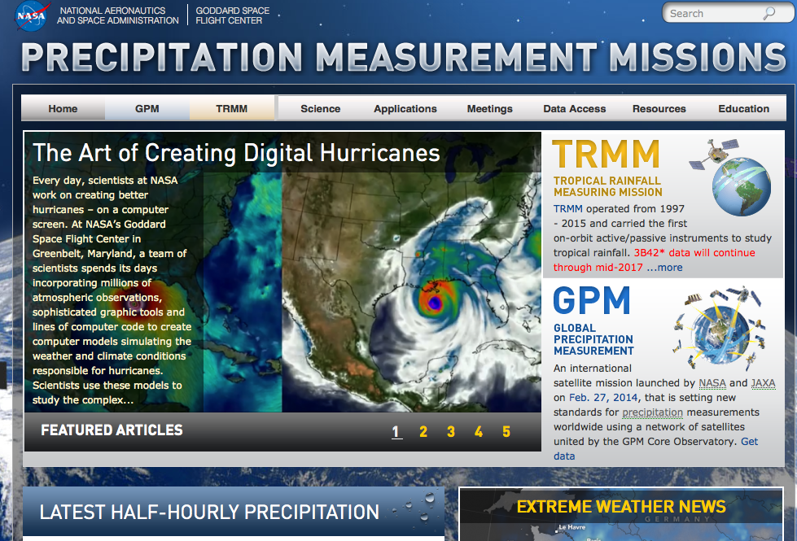
Precipitation Measurement Missions
https://pmm.nasa.gov/
Home of all information related to TRMM and GPM
Links to data documentation and access
Notes:
Home of all the information related to TRMM and GPM
Links to Data Documentation and Access

Slide 39
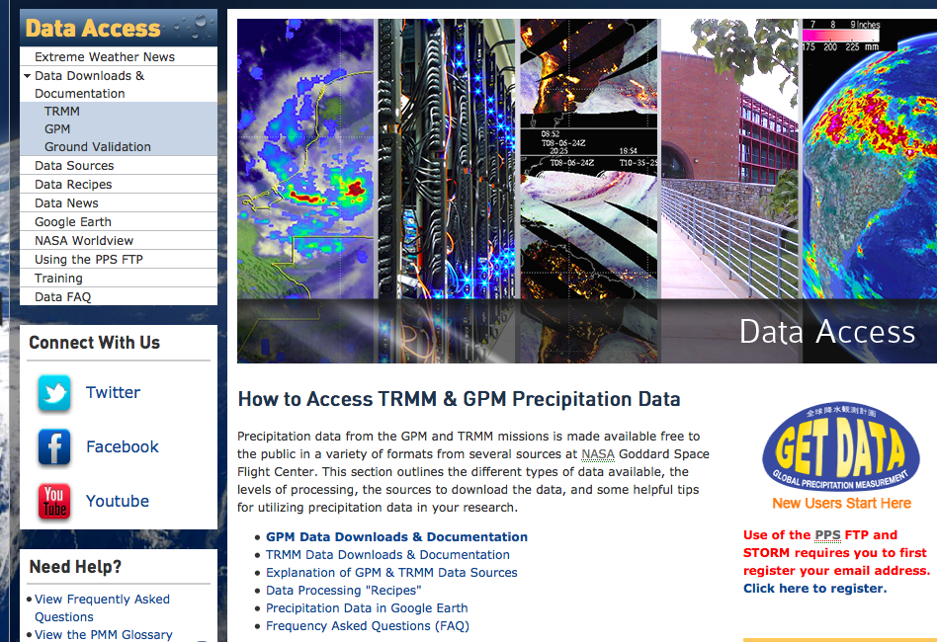
Precipitation Measurement Missions: Data Access
https://pmm.nasa.gov/data-access
All about TRMM and GPM data
Including updates, news, and FAQ
Quick data access links and user registration

Slide 40
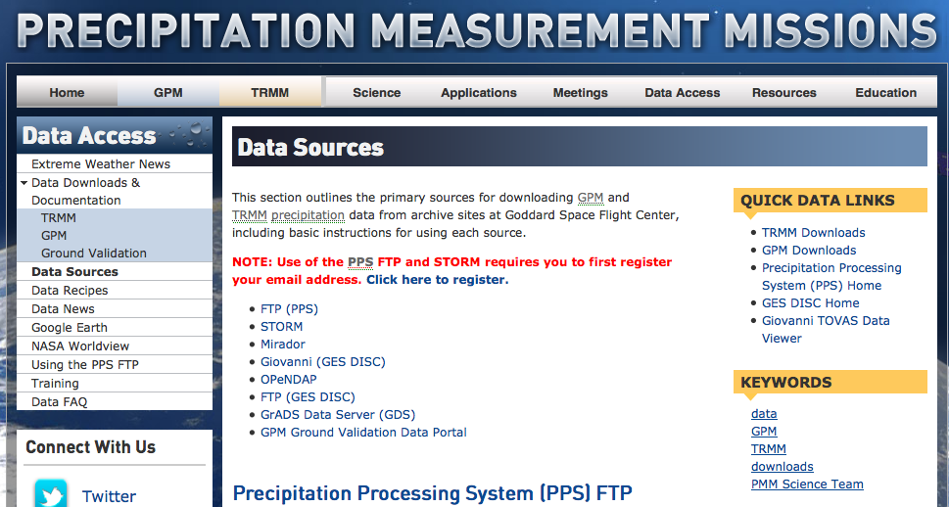
Precipitation Measurement Missions: Data Sources
http://pmm.nasa.gov/data-access/data-sources

Slide 41
PPS & STORM http://storm.pps.eosdis.nasa.gov/storm

Slide 42
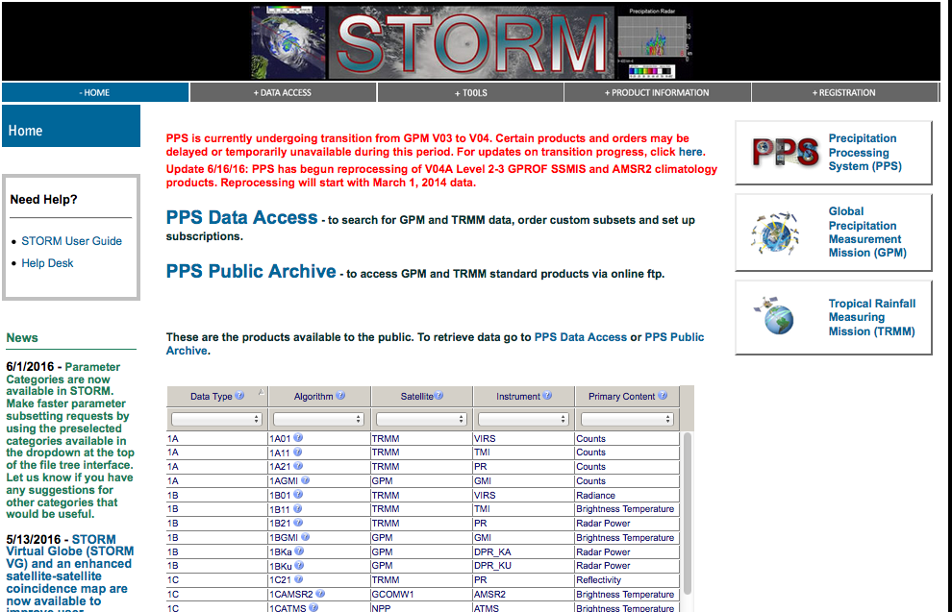
Precipitation Processing System: STORM
https://storm.pps.eosdis.nasa.gov/storm/
All TRMM and GPM data products can be downloaded from STORM
Data images and HDF5 data viewer are available in STORM

Slide 43
Giovanni http://giovanni.gsfc.nasa.gov/

Slide 44
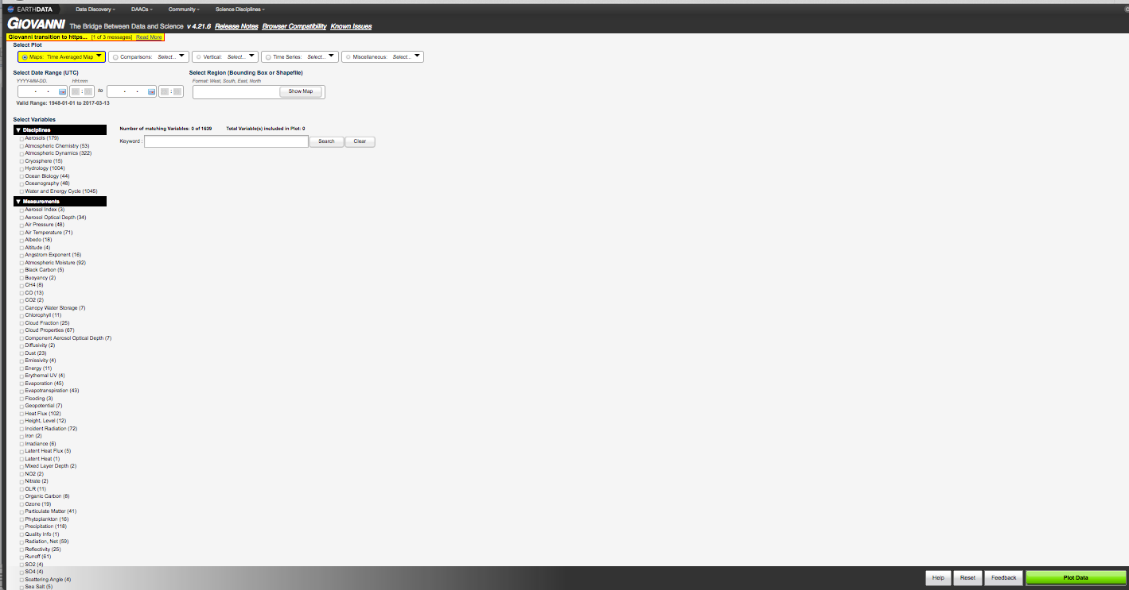
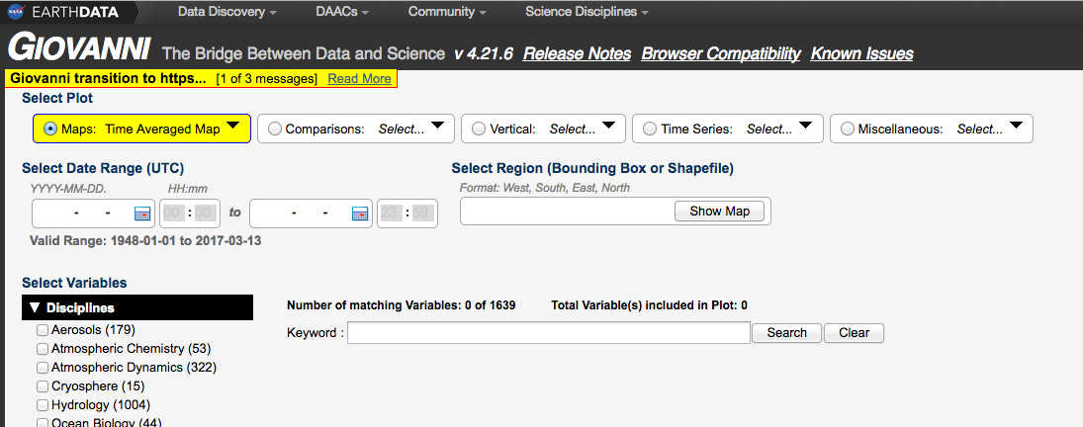
Analysis/Plot Options
Temporal & Spatial Search
Map & Shapefile selection for various countries or U.S. States
Search data by Keyword
Plot Data

Slide 45
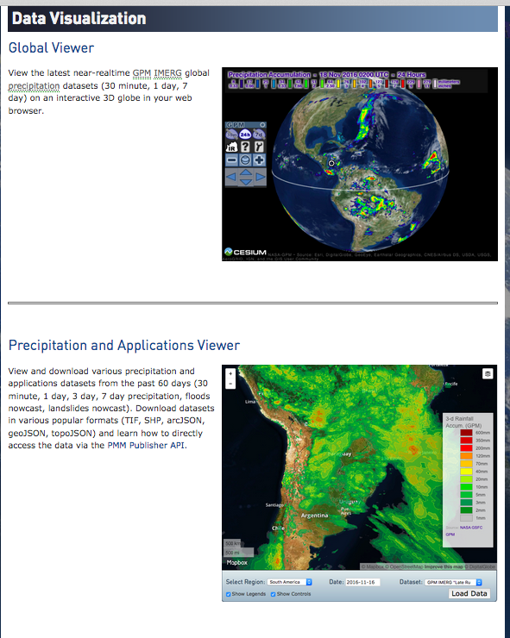
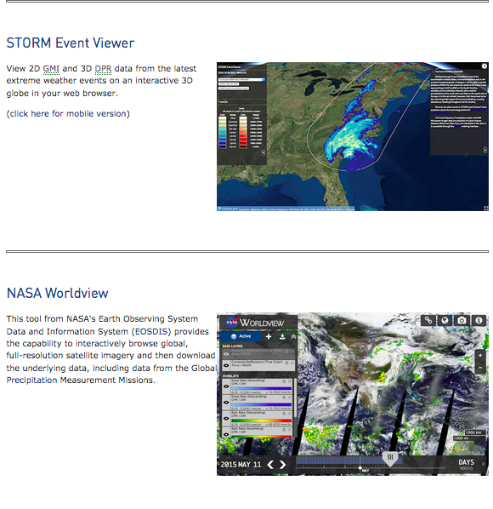
Demonstration: Data Visualization
https://pmm.nasa.gov/data-access/visualization

Slide 46
Demonstration of STORM and Giovanni

Slide 47
Questions for Discussion
What are the major differences between TRMM and GPM?
Why are TMPA and IMERG used the most in applications even though their spatial resolution is lower compared to TRMM and GPM sensor data (Level-2)?
Which data access tool is for bulk data download and not for analysis or visualization?

Slide 48
Next Hands-on Exercise: Precipitation Data Access & Analysis

Slide 49
Extra Slides: GPM Data Validation From https://pmm.nasa.gov/training

Slide 50
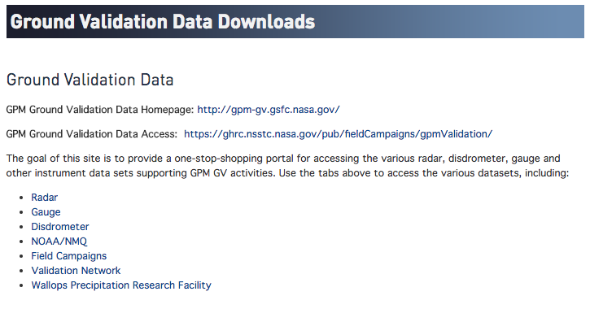
GPM Data Product Validation
http://pmm.nasa.gov/data-access/downloads/ground-validation/
GPM precipitation data are currently being validated with a variety of field measurements

Slide 51
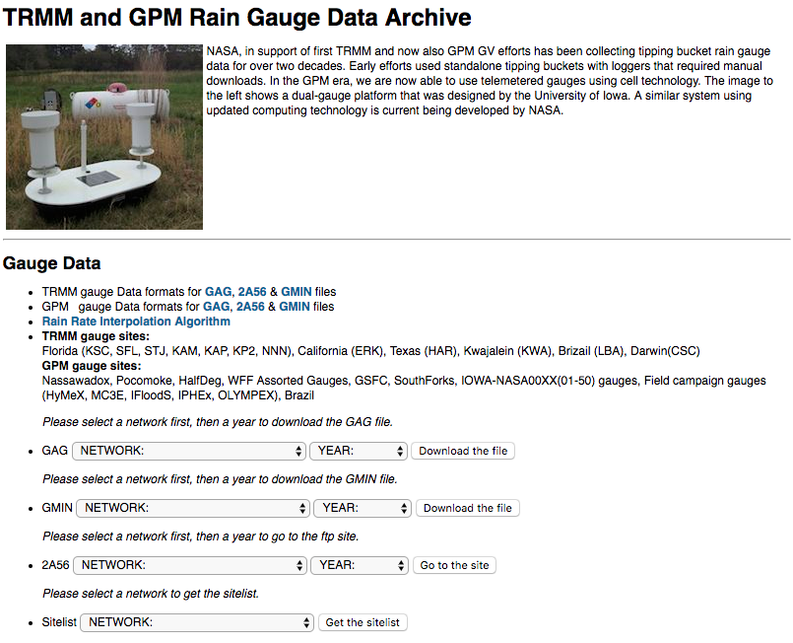
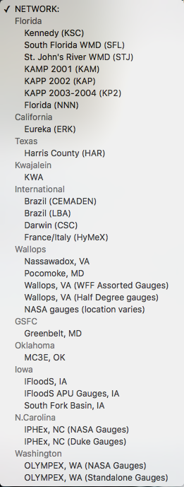
GPM Data Product Validation
http://pmm.nasa.gov/data-access/downloads/ground-validation/
GPM precipitation data are currently being validated with a variety of field measurements

Slide 52
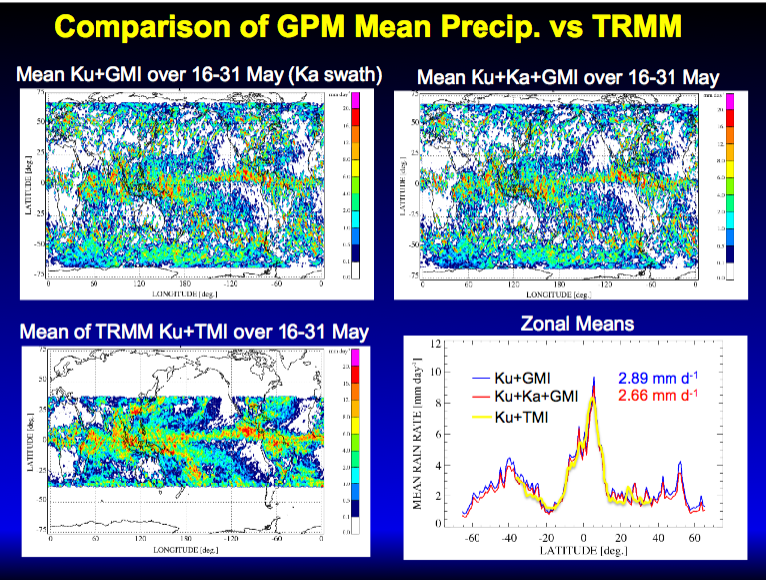
GPM and TRMM Level-2 Data Product Comparison
Higher spatial resolution, coverage, and details in GPM products
Courtesy: William Olson (PMM Investigator), NASA Mesoscale Atmospheric Processes

Slide 53
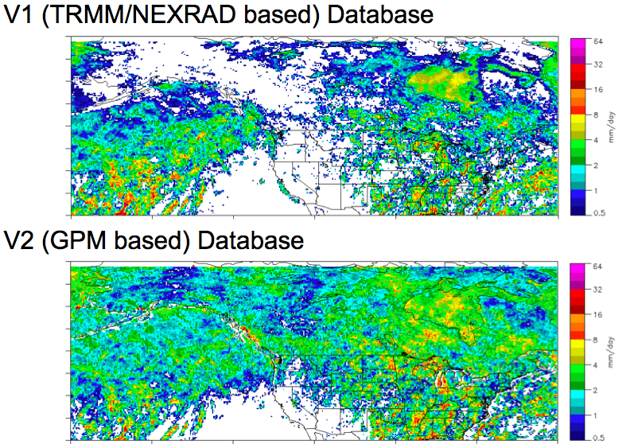
GPM and TRMM Level-2 Data Product Comparison
Improved coverage in GPM GMI product
Courtesy: Christian Kummerow (PMM Investigator), Colorado State University

Slide 54
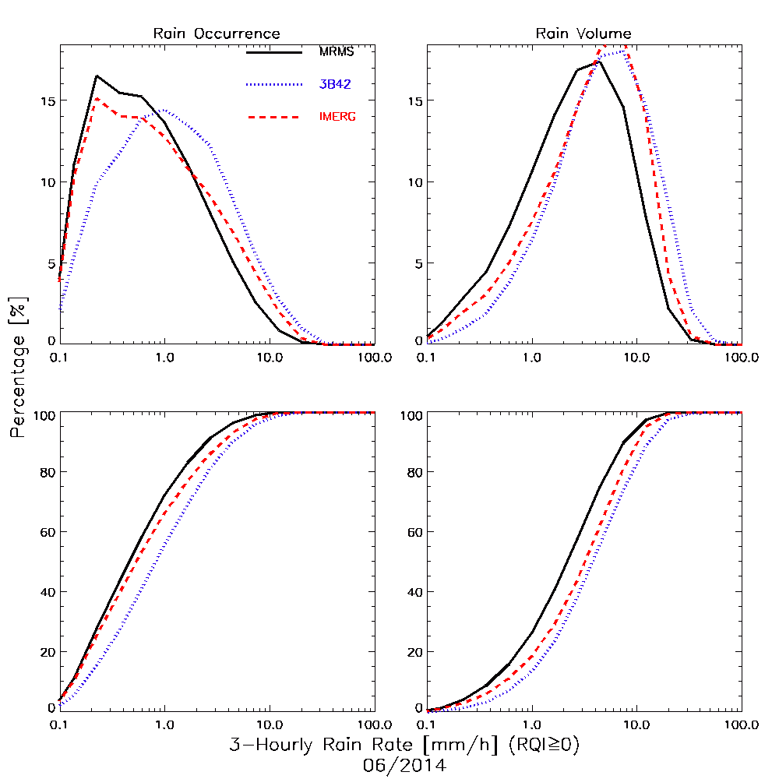
Validation – 3-hourly, 0.25° IMERG, 3B42, MRMS for June 15, 2014
IMERG better than 3B42 for precipitation occurrence
IMERG performs modestly better for precipitation volume
Note: Original footprint GPROF retrievals below 0.1 mm/hr are thresholded to zero
How this affects IMERG depends on the resolution of the input sensor and subsequent averaging (here 0.25°)
Slide Courtesy J. Wang (SSAI; NASA/GSFC 612)
Notes:
3 hourly rain rate June 15, 2014

Slide 55
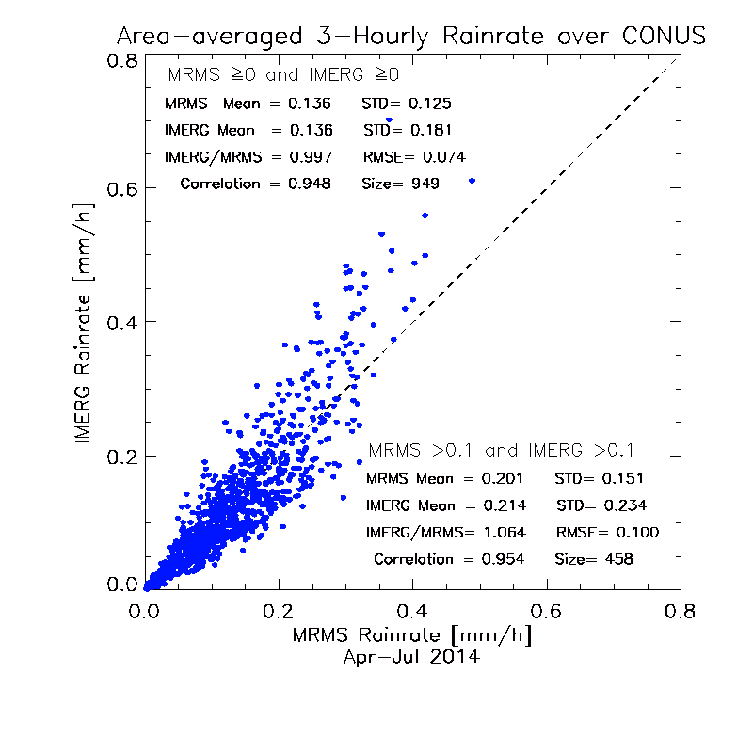
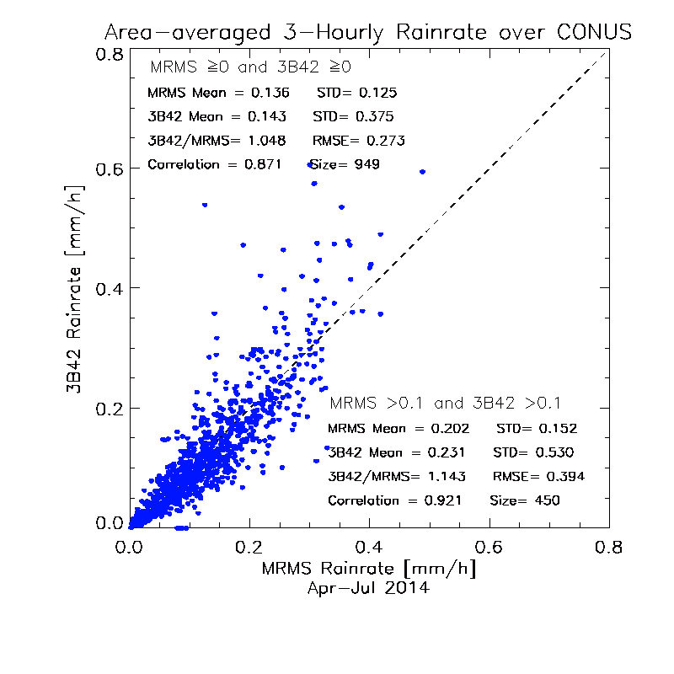
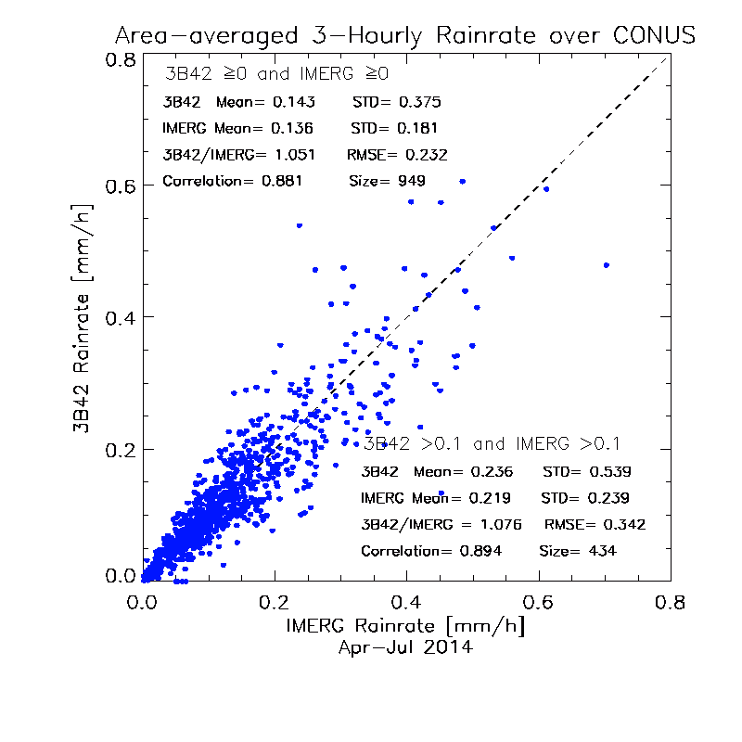
Validation – 3-hourly, CONUS-avg. IMERG, 3B42, MRMS for April – July 2014
IMERG better for bias and RMSE
IMERG and 3B42 trend high at high rates
At this spatial scale, error is roughly multiplicative
Slide Courtesy J. Wang (SSAI; NASA/GSFC 612)

Slide 56
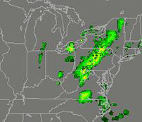
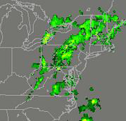
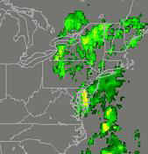
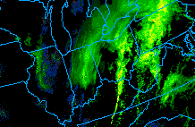
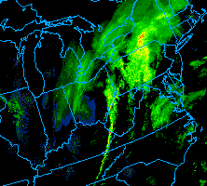
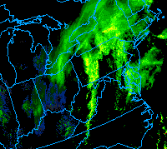
Validation – Snow in IMERG, NWS WSR88D, 12 March 2014
IMERG converted to dBZ, WSR88D in dBZ; both original resolution
Hang-back line in radar missing in IMERG
2-5” of snow with near-blizzard conditions at Cleveland, Ohio, ~1900 UTC
1700 UTC
1800 UTC
1900 UTC
IMERG (dBZ)
1700 UTC
1800 UTC
1900 UTC
WSR88D (dBZ)
Slide Courtesy of B. Rose (Weather Channel)

Slide 57
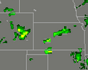
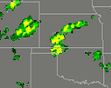
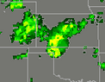
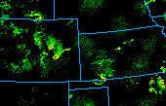
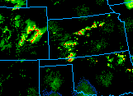
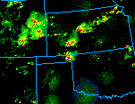
Validation – Supercells in IMERG, NWS WSR88D, July 22, 2014
IMERG converted to dBZ, WSR88D in dBZ; both original resolution
IMERG has good placement of supercells
Anvils more prominent in IMERG, lower maximum values (resolution?)
IMERG (dBZ)
1900 UTC
2000 UTC
2130 UTC
WSR88D (dBZ)
1900 UTC
2000 UTC
2130 UTC
Slide Courtesy of B. Rose (Weather Channel)

Slide 58
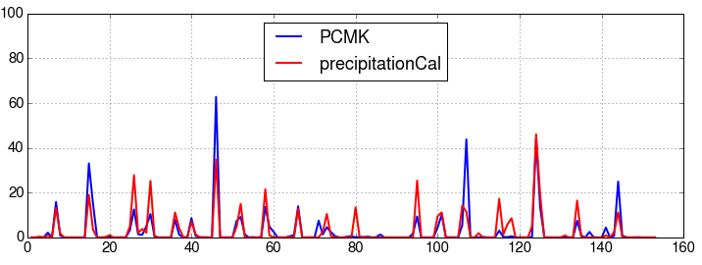
Validation – Daily IERG and Pocomoke Fine-Scale Grid, April-Aug 2014
23 surface gauges in a 6x5 km near Wallops Island, Virginia
Excellent correlation for most events (warm season)
Both over- and under-estimates for largest events
daily accumulation (mm)
days after April 1, 2014
Slide courtesy J. Tan (UMBC; WFF)

